Slide 1
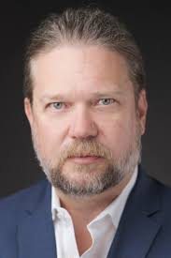
Inaugural Grand Rounds: Kevin Larsen, MD Senior Vice President of Clinical Innovation and Translation at Optum
September 12
12:00 – G5/113
Dr. Larsen will speak to how his team uses data models/predictive analytics to develop risk models across large patient populations, driving practice and quality improvement through clinician facing dashboards
Past roles
Senior health IT advisor at the office of the chief technology officer at the US Department of Health and Human Services
Enterprise strategy and improvement at CMS
Medical director of meaningful use, Office of the National Coordinator of Health IT
CMIO Hennepin County Medical Center
Practices at Hennepin Healthcare, Minneapolis
Associate Professor at the University of Minnesota
Education:
BS – Concordia College, Moorhead, MN
MD – University of Minnesota Medical School

